Slide 1
Limited Books
By Pauline Gwozdz, Steven Tran, Quinn Brimley

Slide 2
We came up with the idea to make a virtual bookstore to allow customers to be able to chat about their favourite books and find one with a click of a button which would also redirect you to a website that you would be able to purchase on.

Slide 3
1.
The main page
A look into our main page set up

Slide 4
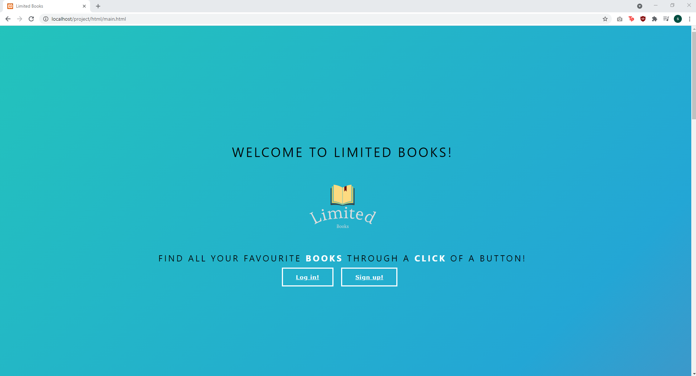
Main Page
Place your screenshot here
This will be the first page when you go onto our website, the main page has 4 sections. This section has 2 links to our sign up or log in page, you must sign up first if you never made an account before to access all our cool features.

Slide 5
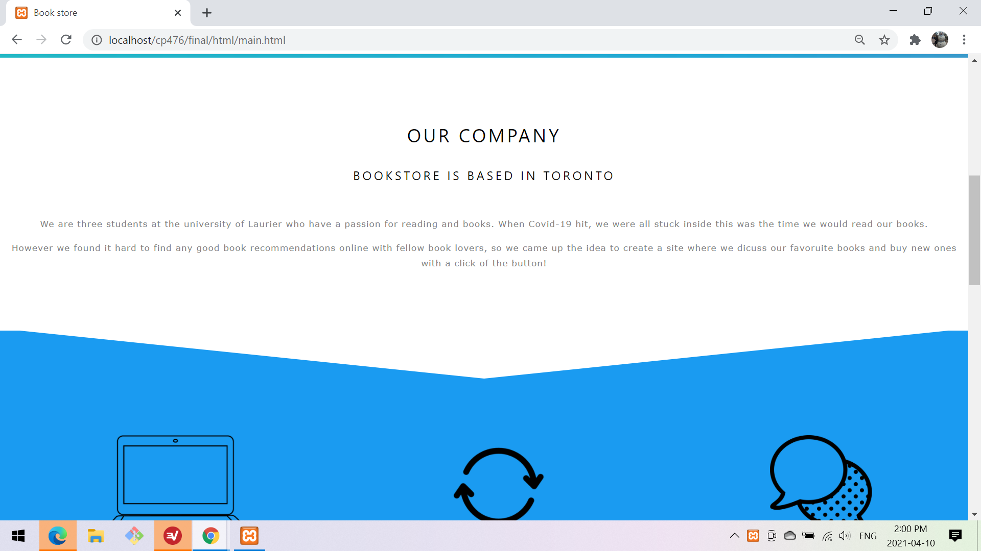
Main Page
Place your screenshot here
This is the second section of our main page, which we called it the “about us” portion. Describing our company and how we came up with the idea for our project.
Our main page was focused on using HTML and CSS to make our clean look as customers enter the website.

Slide 6
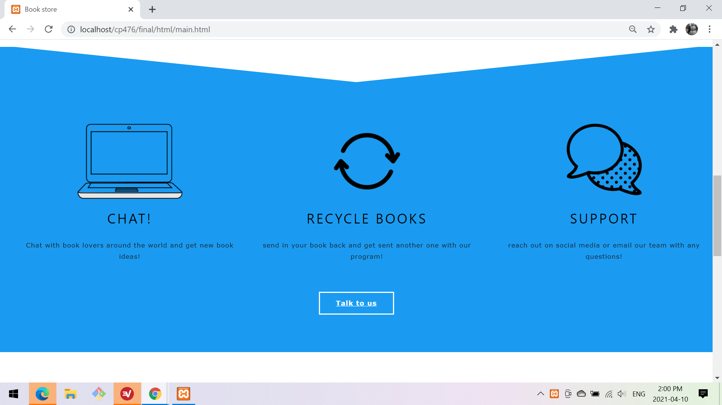
Main Page
Place your screenshot here
Our third section on our main page is the about more of what we do, so you are able to chat with other book lovers, recycle books (we encourage digital books to help the environment) and chat with support with any issues you may have!

Slide 7
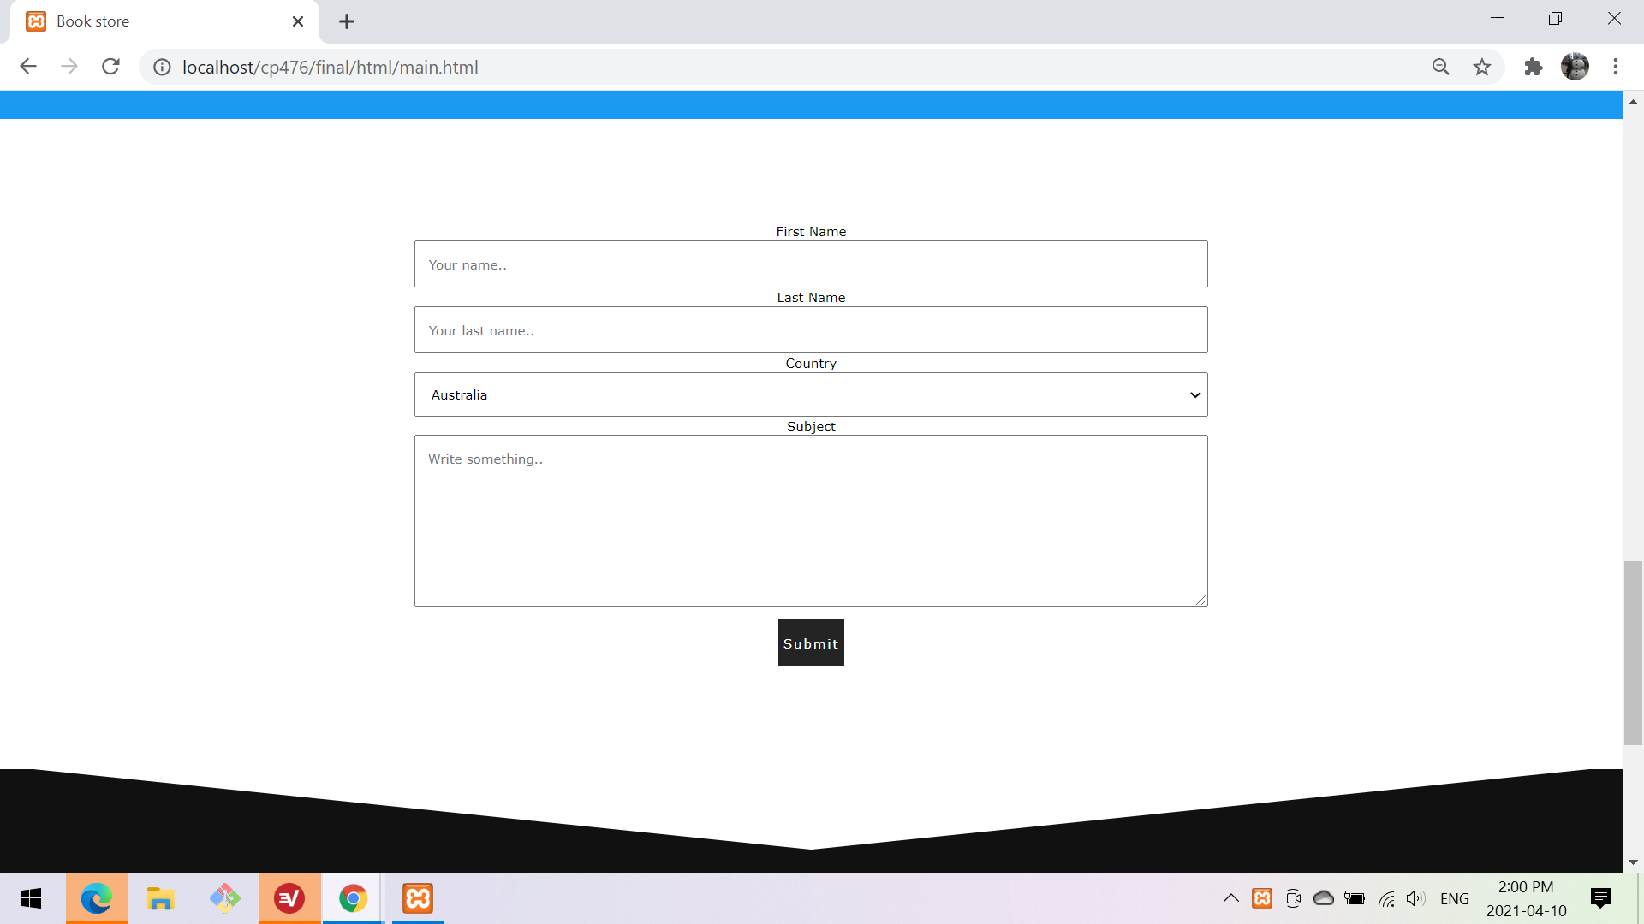
Main Page
Place your screenshot here
Lastly we come to our contact page, so if you clicked the button talk to us the section before it would take you here where you can easily send us an email with any concerns you may have!

Slide 8
2.
Signup & Login Page
A look into our signup and login pages

Slide 9
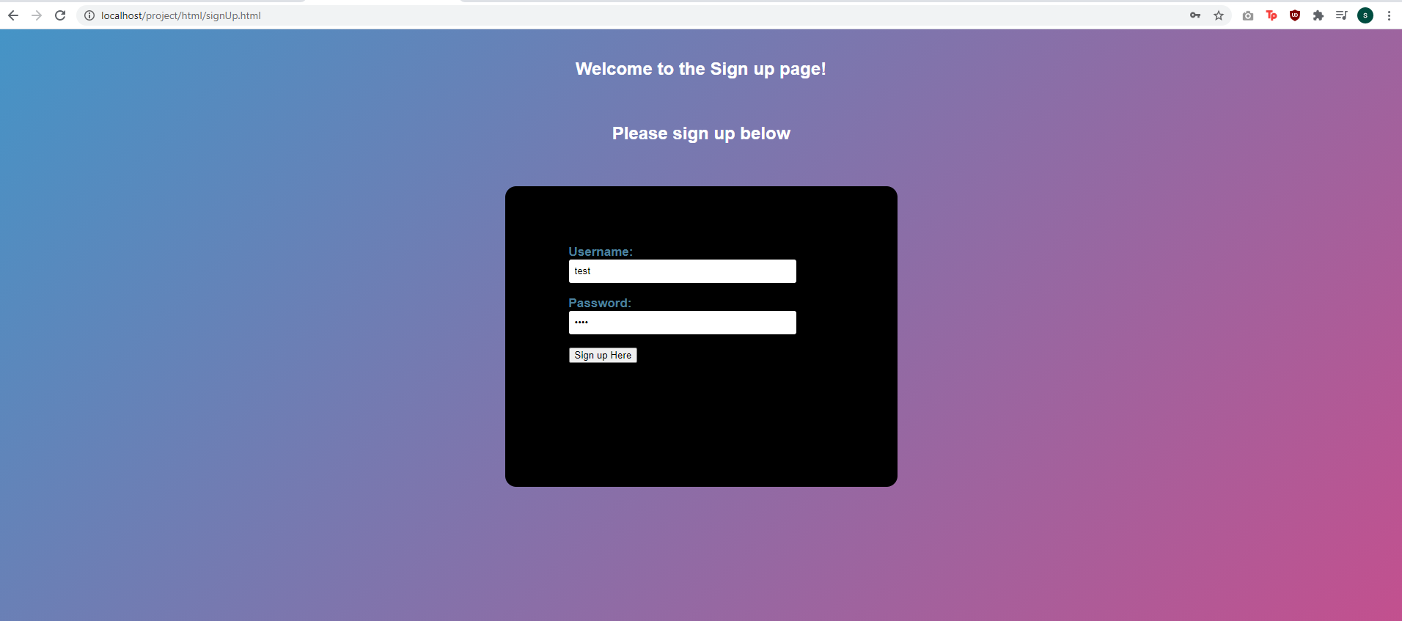
SIGNUP PAGE
Place your screenshot here
If you have never used the site before you must sign up and make an account to use all the features, we save this information in the backend of our project. So that next time you can just log in and be able to access all the features instead of signing up again.

Slide 10
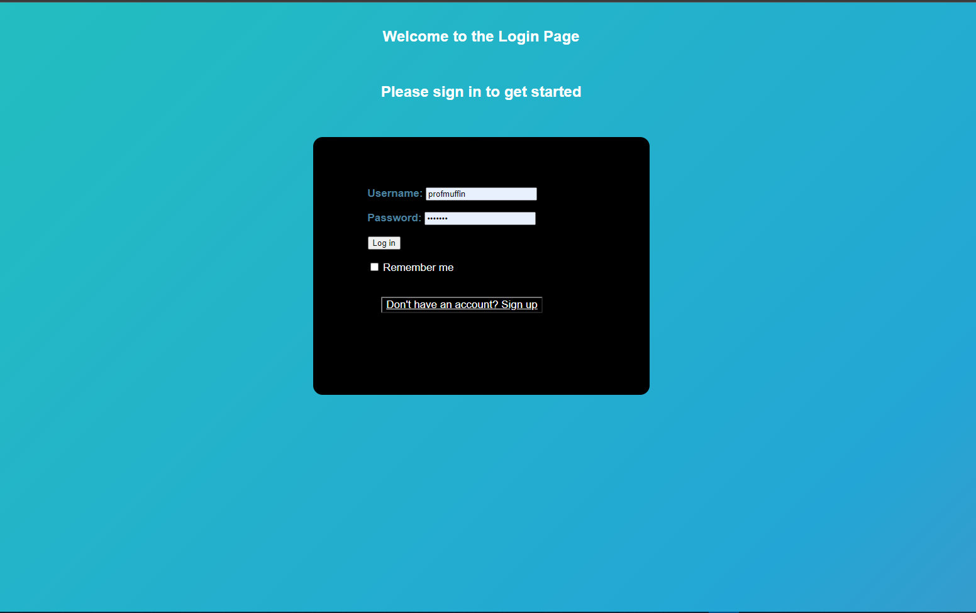
Login PAGE
Place your screenshot here
Once you sign up, we require you login to access the site, once you do all your information is saved and if you click remember me then you will stay logged in, having no issues accessing any part of the website.

Slide 11
3.
Search Page
A look into our search page

Slide 12
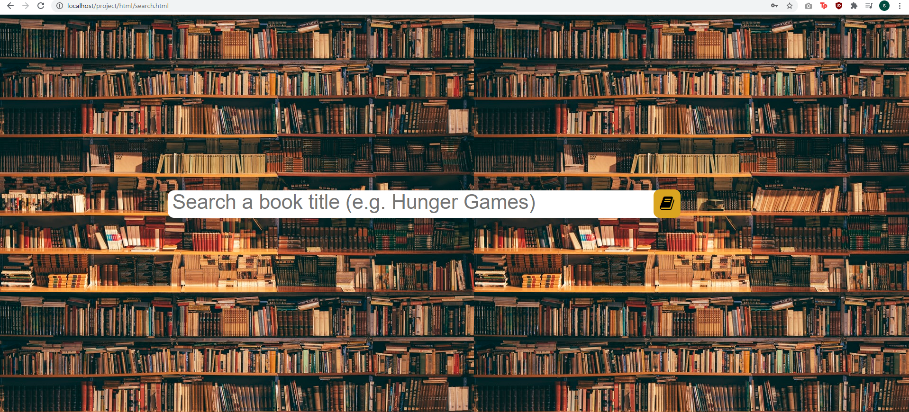
Search PAGE
Place your screenshot here
Here you are able to search for any book you would like, it will give you exact matches but also similar books to your title

Slide 13
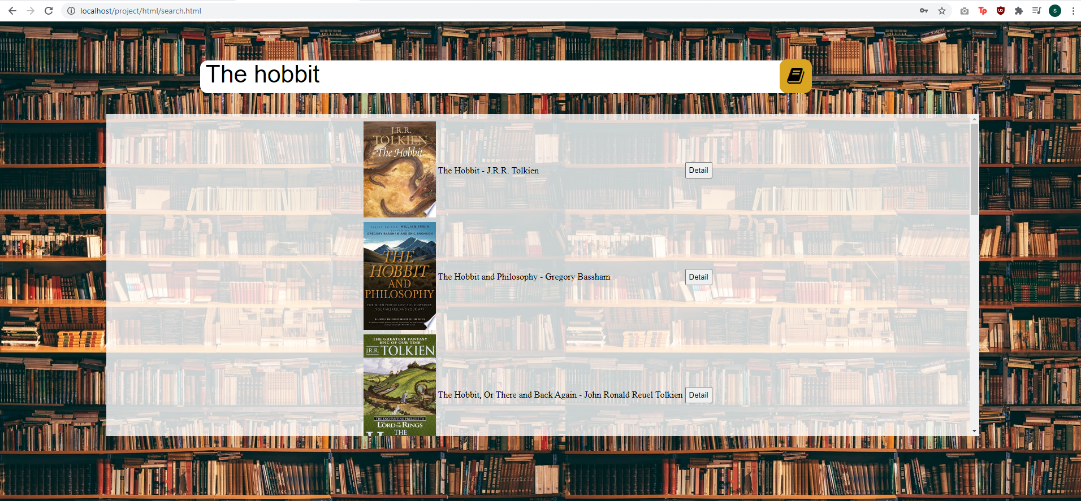
Search PAGE
Place your screenshot here
Once you search up your book, a list of books pops up and you are able to press on any you like which will take you to a detailed page about the book but as well a comment section for the book.

Slide 14
4.
Details Page
A look into our details page for books

Slide 15
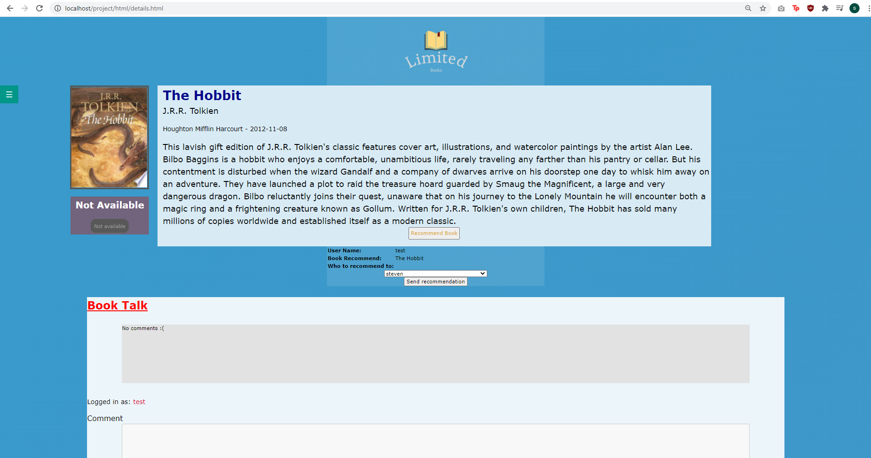
Details PAGE
We set up a lot of options on our details page for each book, once you click on a book you like it provides you with a description of the book, link to purchase, a section to recommend the book to other users and as well as a book talk section where you are able to talk about the book with other users.
There is also a navigation bar on the side to take you any other page on the site.
Place your screenshot here

Slide 16
5.
Profile Page
A look into our profile page

Slide 17
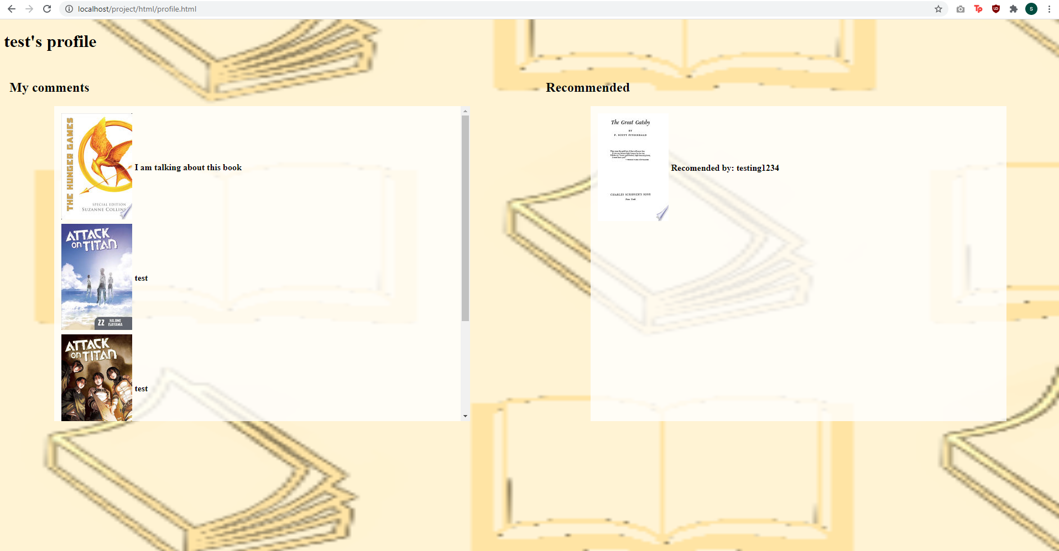
Profile PAGE
Each user who signs up will have their own profile page. This page allows your to change your username but also shows you each book you have left a comment on, incase you ever want to go back. We also set up a section for books that other users recommend to you, so you can easily look through what you want to read next!
Place your screenshot here

Slide 18
How we set up our site
A look into the development

Slide 19
Our process....
Brainstorming
Creating the front-end
Creating the back-end
Implementing everything together

Slide 20
Languages we used for our project
HTML
PHP
JS
CSS
MYSQL
AJAX

